Slide 1
Startup error
!
Light OS Technologies
Press TAB and ENTER to boot into recovery mode, where you can perform a factory reset or system update
Loader: LightBoot 3.0
Date: 2024-12-08
Boot delay: 1 second(s)
Macros disabled
Codename OrangePath OS
Build 997
For evaluation purposes only
Macros disabled
1

Slide 2
Troubleshooting startup errors
Sunlight OS may fail to start up for the following reasons:
The user left „Disable all macros“ checked when starting the slideshow
Macros have been disabled automatically due to settings in PowerPoint or an external policy
There’s a major programming error in VBA project (usually in PageChange subroutine or a syntax error somewhere else)
You are attempting to run this PPTOS using Office for Mac, which doesn’t support importing functions from Windows DLLs
You are attempting to run this PPTOS on a version of Office, which does not support macros (e.g. mobile and web versions)
Error testing is enabled – to disable it, edit the value of „ErrorTest“ shape on Slide 2 and make sure it’s not set to „True“
!
Startup error
What does this mean?
Exit
Codename OrangePath OS
Build 997
For evaluation purposes only
False
← Test startup error?
False
← Is hibernated?

Slide 3

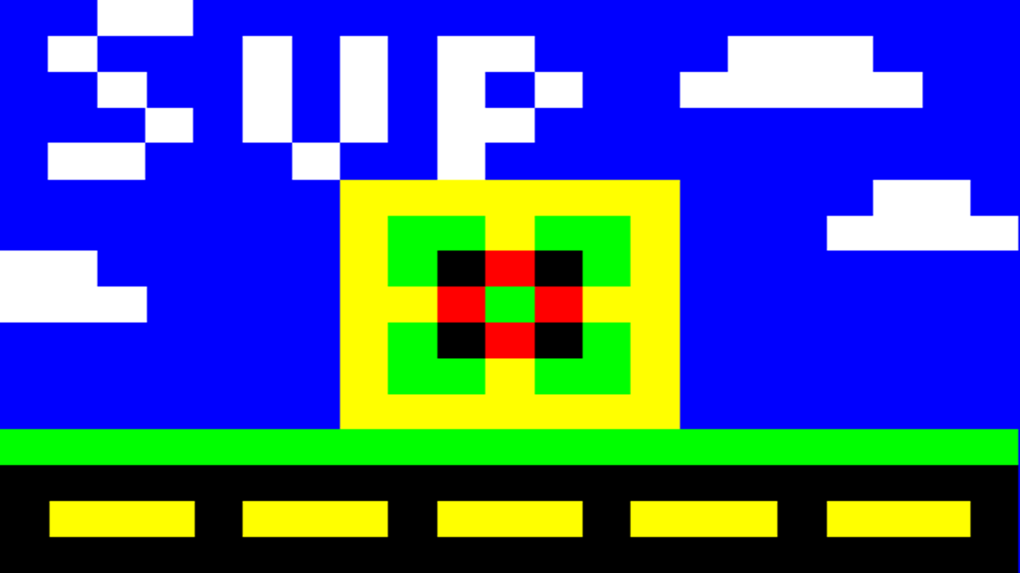
Welcome, Admin!

Slide 4

/Users/Admin/Desktop/
/Users/Admin/test
/Defaults/Presentations/Demo.pres
Launching Menu...
Menu
N/A
Theme.thm
sup.png
background.jpg
checkered_flag.png
lol4.pres
lol.pres
lol3.pres
2
False
False
Admin
Codename OrangePath OS
Build 997
For evaluation purposes only
7 items
/Users/Cat/
AppName
AppName
Workspace 1
15:53

Slide 5
←
↻
New
Open
Save
Save as..
Font
/
←
↻
/Users/Admin
FS
←
→
Good afternoon, Admin!
←
→
B
I
U
S
ST
____
____
____
____
____
____
____
____
____
New
Open
Save
Save as..
Show
B
I
U
S
__
__
__
__
__
__
__
__
__
Size:14
R
+
-
BG
Insert date and time
File systems
*
Click on the application name to kill it
Welcome to Sunlight Shell!
Type ‘help’ and press <Enter> to see available commands
TextBox
<--
-->
/\
|
|
\/
x
Mode: Move
Pic
Font
-
+
Add/Modify text
0
Virtual Filesystem (ShapeFS)
*
+
__________________
0
Color 1
Gallery
No image file loaded
Loading…
User
50?
←
→
No video file loaded!
ActiveX
Miscellaneous
User account
Personalization
Welcome to Sunlight OS!
Color 2
TextBox
Disable
Local Disk C: (Windows)
Personalise
Shapes
Load error. File does not exist!
7
8
9
+
I’m thinking of a number between 1 and 100. What number am I thinking about?
Your guess: 50
It works!
Autosave
Disable
User account
You have a password
!
Disable
Word wrap
i
X
Disable
Debug mode
Calculator
Settings
Task Manager
Guess the number
Pixel Paint
Enter your password
Notepad
Personalise
Sunlight OS has many ways to customize it to fit your desires and needs using the settings app!
Sample content
See what Sunlight is capable of by exploring the files in /Defaults directory!
TBD
ModalFiles
No file loaded!
Change
4
5
6
-
Rename
ActiveX
Note: Disabling ActiveX requires a user account with no password set.
Change colors
Load file
Import update package
Save file
Disp. shape
Window templates
>_
Miscellaneous
Autologin active
____________
Copy
Change background
____________ ___
!
Open ‘Settings’
Open ‘Files’
Message
1
2
3
*
Aa
Recovery mode
Nobody
Disable
-1
+1
Guess
About
Sunlight OS
Info
5
Generic
Error
Exclamation
Create your own apps
With Sunlight OS, development of custom apps for a PowerPoint OS has never been easier thanks to custom APIs and specialized macros!
Change theme
Paste
OK
Need more help?
Sunlight OS has you covered! With the help application, you can find more info about using the built-in applications!
Save settings now
Add user account
,
0
=
/
-10
+10
Presentator
Shell
Files
Words
InputBox
OK
Gallery
Welcome to Sunlight!
OK
Export
Delete
Build: XXX
Space usage: 0 kB
ShapeFS inodes: 0
User accounts: 0
DFU version: 0.0
Panic system: 0.0 (test)
/Defaults/Themes/Default.thm
Message testing
Hello world!
Disable load indicators
x+
y+
z+
Title
Text
Delete this user
Load
New
Open
Save
Tutorials
Clear
Open ‘Help’
New folder
Reset
Save
?
x-
y-
z-
Refresh
Clear
Select
Help
Slide 1
void
x
<--
-->
Save
0 items
←
→
/0 files
Hibernate
Log off
Restart
Shut down

Slide 6
It's now safe to close the presentation
Codename OrangePath OS
Build 997
For evaluation purposes only
False
Restarting…

Slide 7






/Users/johnny/Desktop/
Window title
Borderless [Trafficlight]
Window title
_
_
X
Window title
X
Each shape can be...
_
X
Window title
Window title
_
X
Available shapes
Metallic
So, why is it so awesome?
Modern
Neon
OrangePath default
There are 5 modes for manipulating shapes...
Welcome to Presentator 3!
Regular
_
X
Window title
1. Moved
/Defaults directory
Moonlit
1. Support for a lot of shapes!
Bold
1. Move - allows you to move shapes across the slide
2. PMove - allows you to move shapes pixel by pixel
2. Infinite number of slides!
Italic
2. Resized
Thank you!
3. Size - allows you to resize shapes
Text formatting
3. Shape movement, scaling and rotation!
4. PSize - allows you to resize shapes pixel by pixel
Underline
4. Infinite number of presentation files!
Button
5. Rotate - allows you to rotate shapes 1° with horizontal arrows or 45° with vertical arrows
Window title
_
X
I hope you liked this presentation showcasing a presentation editor inside a presentation editor!
5. Multiple instances!
Shadow
Wood
3. Rotated
Button
Button
6. Images!
Button
Strikethrough
Button
Powered by
Light OS Technologies
Button
0 items
Button
Go back
Set as background
Set as user picture
Hide controls
/Users/Cat/

Slide 8
!
Recovery mode
Continue boot
Restart system
Factory reset
System update
Shut down system
Macro test

Slide 9

fasfasfsf
False
True
Admin
1
/System/Icons/Words.emf
Words
;
General system files

Slide 10

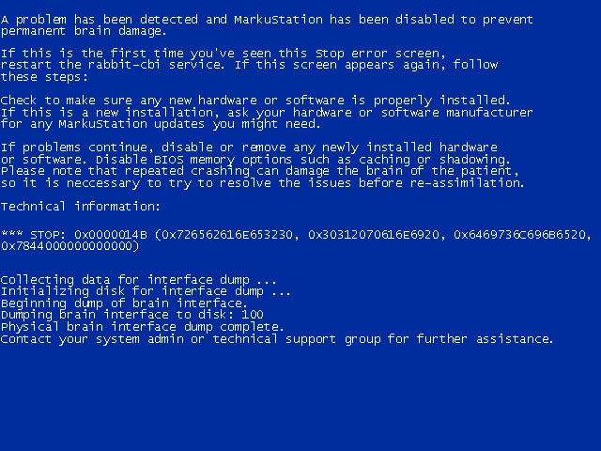
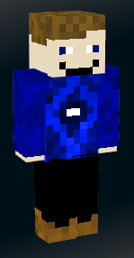
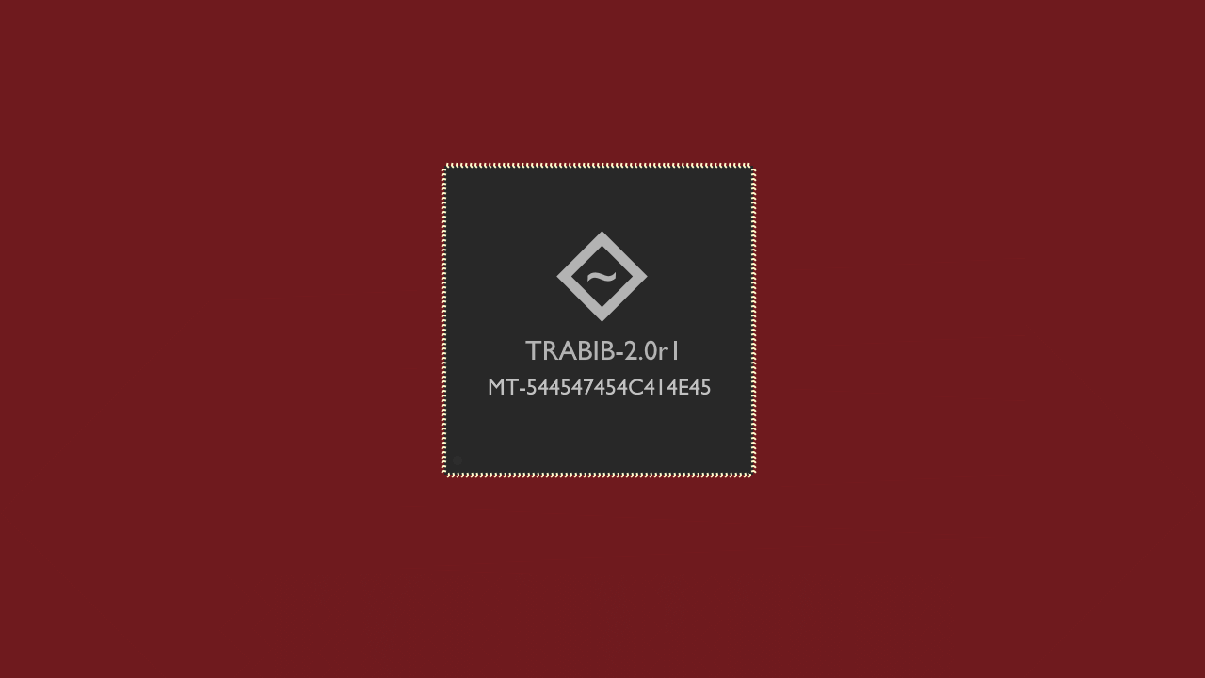







/Users directory
Borderless [Trafficlight]
Window title
administratorhasmanyrights
3
Window title
hi.
Borderless [Trafficlight]
trololololololololollollololololololololol
lolololololololololololololol
Each shape can be...
Available shapes
So, why is it so awesome?
There are 5 modes for manipulating shapes...
Welcome to Presentator 3!
Regular
1. Moved
lolololololololololololololol
1. Support for a lot of shapes!
Bold
1. Move - allows you to move shapes across the slide
2. PMove - allows you to move shapes pixel by pixel
2. Infinite number of slides!
Italic
2. Resized
Thank you!
3. Size - allows you to resize shapes
Text formatting
3. Shape movement, scaling and rotation!
4. PSize - allows you to resize shapes pixel by pixel
Underline
Button
4. Infinite number of presentation files!
5. Rotate - allows you to rotate shapes 1° with horizontal arrows or 45° with vertical arrows
I hope you liked this presentation showcasing a presentation editor inside a presentation editor!
5. Multiple instances!
Shadow
3. Rotated
6. Images!
Strikethrough
Powered by
Light OS Technologies

Slide 11
null
DFU 0.2
!
Missing update file
In order to update, an update file must be selected first!

Slide 12

Please wait…
Shut down
Restart
Guest session

Slide 13
2
Select a user account
Admin
User
Shut down
Restart
Guest session

Slide 15


Slide 16
Change password
Current password
New password
Confirm password
Cancel
Update password

Slide 17
Add user
Username
Password (optional)
Confirm password
Cancel
Add user

Slide 19
True
Sunlight setup
X
Partition setup
Welcome to Sunlight!
Please choose where to install Sunlight OS
We first need to know a few things, before setting up the PPTOS. First of all, what type of installation would you like to do?
Fresh install
No settings will be imported
Upgrade
Import settings from a previous version of Sunlight
Migrate
Import settings from another PPTOS
Please wait…
Next
1 Colecting info
2 Installing

Slide 20
False
Add user
Username
Password (optional)
Confirm password
Welcome to OrangePath/OS!
Enable autologin
Looks like you’re new here. First, welcome! In order to start using my most advanced PowerPoint OS, you must setup a user account first. You can create new accounts or remove existing ones later using the settings app.
Back
Add user

Slide 21
Hibernating…
Do not close PowerPoint or press Escape during this process!

Slide 22
Hello, world!
fuck off
C:\
True
False
3
True
19
/Users/Admin/Desktop/lol.pres
false
zzDeployIcon

Slide 23

Panic screen
Source: OrangePath
Description: The specified value is out of range.
:(
Well, this is embarrassing!
Sunlight OS has run into a problem and needs to restart. Please wait, while we save settings and then restart for you…

Slide 24
Window title
_
X
Window title
_
X
OrangePath default
>_
__________________
____________
OrangePath default
Administrators:Shell
Everyone:Task Manager
Everyone:Notepad
Everyone:Presentator
____________ ___
User
User
Administrators:Files
Everyone:Calculator
50?
Everyone:Guess the number
Administrators:Settings
!
?
Everyone:Pixel Paint
Aa
Everyone:Welcome to Sunlight!
Everyone:Help
Everyone:Gallery
Everyone:Words

Slide 25
Restarting…

Slide 26
Teleports to last slide

Slide 27
Design slide
Slide24
____________
Button

Slide 29
_
_
X
Good evening, Test1!
X
Presentator – Untitled presentation
File Explorer
X
File chooser
B
I
U
S
____
____
____
____
____
____
____
____
____
_
ST
New
Task list
X
←
↻
Open
Save
Show
/
Settings
_
X
_
X
Shell
>_
←
↻
/
←
→
50?
Calculator
_
X
_
X
Paint
_
X
Settings
Click on the application name to kill it
Calculator
_
X
Font
-
X
Add/Modify text
<--
-->
/\
|
|
\/
x
Mode: Move
_
+
Picture viewer
_
X
Welcome to OrangePath Shell!
Type ‘help’ and press <Enter> to see available commands
3D Rotate
TextBox
File systems
Debug mode
*
0
_
X
Video player
Enable
*
+
0
Color 1
Debug mode
_
X
Notepad
0
Enable
No image file loaded
+
User
0
X
Files
Virtual Filesystem (ShapeFS)
You know this isn't going to work, right?
X
No video file loaded!
Shell
Calculator
Settings
Task Manager
Guess the number (Guesses: 0)
_
X
Guess the number
Pixel Paint
Shapes
Color scheme
Color 2
TextBox
Color scheme
Change
Enter a new name for 'BootlogoSplash.3d'
Read-only file system
7
8
9
+
Change
I’m thinking of a number between 1 and 100. What number am I thinking about?
Your guess: 50
7
8
9
+
Local Disk C: (Windows)
!
i
__________________
X
____________
____________ ___
Autosave interval: 11 mins
-1
+1
Autosave interval: 11 mins
4
5
6
-
+1
-1
4
5
6
-
Window templates
Rename
Desktop background
Change
Desktop background
1
OK
Change
Notepad
Presentator
Files
2
3
*
-1
+1
Guess
Copy
53
1
2
3
*
Autologin active
Disable
Autologin active
Disable
,
0
=
/
Paste
-10
+10
OK
No password set
z+
x+
y+
Export
,
0
=
/
No password set
Set
Set
Delete
New
BG
FG
Open
Save
Load
x-
y-
z-
Clear
Reset
Delete this user
Add user account
Save
Clear
Reset
New dir.
Delete this user
Add user account
Refresh
Clear
Recovery mode
Save settings now
Recovery mode
Save settings now
Slide 1
void
x
<--
-->
Select mode
Save
0 items
/0 files
←
→
Hibernate
Log off
Restart
Shut down

Slide 30
Developer macros (Ribbon → Developer → Macros)
aaDevCreateApp = Generate new application
aaDevRemoveApp = Delete application
aaDevAddMacroActions = Add launch macro to menu icon action settings
aaDevListApps = Lists all installed applications
aaDevNameThatSlide = Displays the actual name of a specified slide
aaDevDesignIcon = Edit icon for an application
aaDevDeployIcon = Apply designed icon to an application
aaDevExport = Exports modules and presentation wihtout macros for VCS
aaDevEditApp = Allows you to design an existing app
aaDevRefreshApp = Allows you to apply any changes to the edited app
aaDevCheckDuplicates = Checks for duplicate shapes on design slide
Quick goto (Ctrl+Click)
Window templates
Desktop
Protected filesystem
Root filesystem
Users directory
Variables
App icons
Design slide
?
Login UI
Panic screen
Recovery mode
Fullscreen window
Everyone:Test application

Slide 31
Please wait…

Slide 32
Welcome to Sunlight!
X
We first need to know a few things, before setting up the PPTOS. First of all, what type of installation would you like to do?
Fresh install
No settings will be imported
Upgrade
Import settings from a previous version of Sunlight
Migrate
Import settings from another PPTOS
!
Upgrade is not available in this version of Sunlight/OS
Next
Next
Next
1 Colecting info
2 Installing

Slide 34
Migrate
X
To migrate, please select one of the supported PPTOSes from the list below. You’ll be prompted to browse for the PPSM file. Please MAKE SURE you select a compatible file, otherwise this process won’t work.
Light OS
Light OS Modern
!
Not migratable to this version of Sunlight OS
Back
Analysing PPSM file…
1 Colecting info
2 Installing

Slide 35
Who is going to use this PC?
X
Please enter usernames for everyone using this computer. You can set passwords after the setup has been completed.
User 1
User 2
User 3
User 4
User 5
Automatic login
Next
1 Colecting info
2 Installing

Slide 36
Personalize
X
Choose your preferred color scheme
Theme example
X
This is an example of what this color scheme looks like
i
OK
Back
Next
1 Colecting info
2 Installing

Slide 37
Ready to install
X
We are ready to start the installation. Make sure that the following info is correct and press Next to start the installation process.
Data import:
N/A
User accounts:
Admin
Autologin enabled
Color scheme:
Green
Back
Next
1 Colecting info
2 Installing

Slide 38
Installing…
Do not close the presentation during this process! Cancelling the process may cause data corruption.
1 Colecting info
2 Installing
0

Slide 39
Finshed
Restart
X
Sunlight OS setup was completed successfully. Please restart or shut down to finish setup.
1 Colecting info
2 Installing

Slide 40
Installation failed
Restart
X
An error occurred while trying to install Sunlight OS. Please restart the system to try again!
Error details:
Copy error
Access is denied
1 Colecting info
2 Installing

